Slide 1


Walking and Working Surfaces
Damon Dearmon
National account manager
Safety rail company
Minneapolis, Minnesota
612-500-8504 Cell

Slide 2
Walking and Working Surfaces
Presentation Objectives
-Define OSHA Safety Standards for Walking and Working Surfaces
-Identify How These Standards Have Recently Changed
-Provide Expertise on How to Remain in Compliance

Slide 3
Walking and Working Surfaces
OSHA Safety Standards
OSHA Standard 1910
-Addresses slips, trips, and fall hazards in general industry
-Includes surfaces like floors, aisles, stairs, ladders, roofs, platforms, etc.
-Fall protection needed when performing work at least 6 feet but less than 15’ from edge (including guardrails or fall-arrest/fall-restraint systems)
-Ladders – Fall protection guarding is necessary for 4’ or more in elevation change

Slide 4
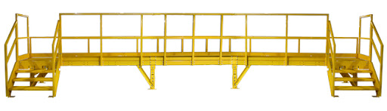
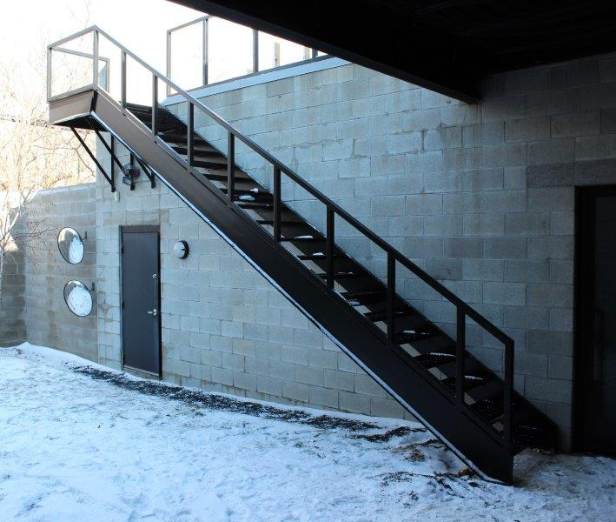
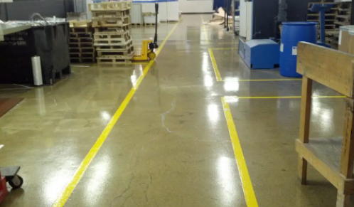
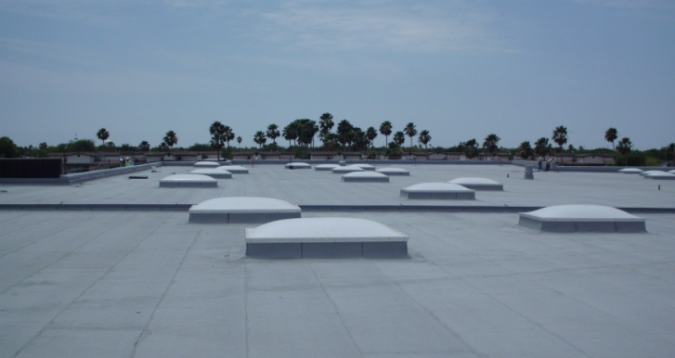
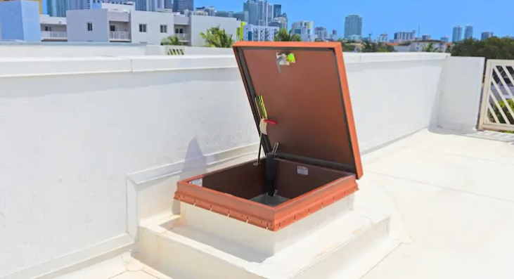
Walking and Working Surfaces
OSHA Safety Standards

Slide 5
Walking and Working Surfaces
Presentation Objectives
2020 TOTALS
Fall Protection – General Requirements (1926.501): 5,424 violations.
Hazard Communication (1910.1200): 3,199.
Respiratory Protection (1910.134): 2,649.
Scaffolding (1926.451): 2,538.
Ladders (1926.1053): 2,129.
Lockout/Tagout (1910.147): 2,065.
11% Reduction from 2019 for falls

Slide 6
Walking and Working Surfaces
Presentation Objectives
2019 AVERAGE COST
Average cost for medical injury $42,000.00
Average cost per death $1,220,000.00
Average cost to protect a facility $150,000.00 -$175,000.00

Slide 7
Walking and Working Surfaces
OSHA Safety Standards
Methods for Eliminating Hazards
-Regular Inspections
-Use of fall protection including covers, designated areas, guardrails, handrails, personal fall-protection systems, ladder safety systems, and safety nets

Slide 8
Walking and Working Surfaces
Updated Standards
OSHA’s Final Rule: Walking and Working Surfaces (Effective Jan. 2017)
-Applies to all general industry entities: purpose is to increase both jobsite safety and consistency between general industry & construction
-Also updated to reflect advances in technology and to incorporate plain language to make final rule easier to understand and follow

Slide 9
Walking and Working Surfaces
Updated Standards
Specific Regulatory Changes
-Fall Protection Flexibility: Performance-based language allows employers to choose from a range of accepted fall-protection systems
-Added requirements for inspection and maintenance of personal fall- arrest systems

Slide 10
Walking and Working Surfaces
Updated Standards
Ladder Safety System
-Applies to ladders that extend over 24 feet
-Phase-In: Ladder cages will be phased out over 20-year period, replaced with ladder safety or fall-arrest systems (Deadline: November 18, 2036)
-Final Rule grandfathers in cages and wells on existing ladders, but requires updated standards on new ladders

Slide 11
Walking and Working Surfaces
Measures to Ensure Compliance
Areas that OSHA considers a hazard
-Elevation changes of more than 4’ (general industry)
-Roof hatches
-Skylights
-Ladders

Slide 12
Walking and Working Surfaces
Measures to Ensure Compliance

Slide 13
Walking and Working Surfaces
Measures to Ensure Compliance
OSHA-Compliant Measures to Ensure Safety
-Guardrail Systems
-Warning Line Systems
-Safety Nets
-Personal Fall-Arrest Systems (PFAS)

Slide 14
Walking and Working Surfaces
Measures to Ensure Compliance
Guardrail System Compliance (1910 Subpart D / 1926 Subpart M)
-Height of 42” (plus or minus 3”) with no opening more than 19”
-Midrail positioned between top edge and walking working surface
-Capable of withstanding 200 pounds of force (150 on midrail)
-Required toeboard when falling objects are present

Slide 15
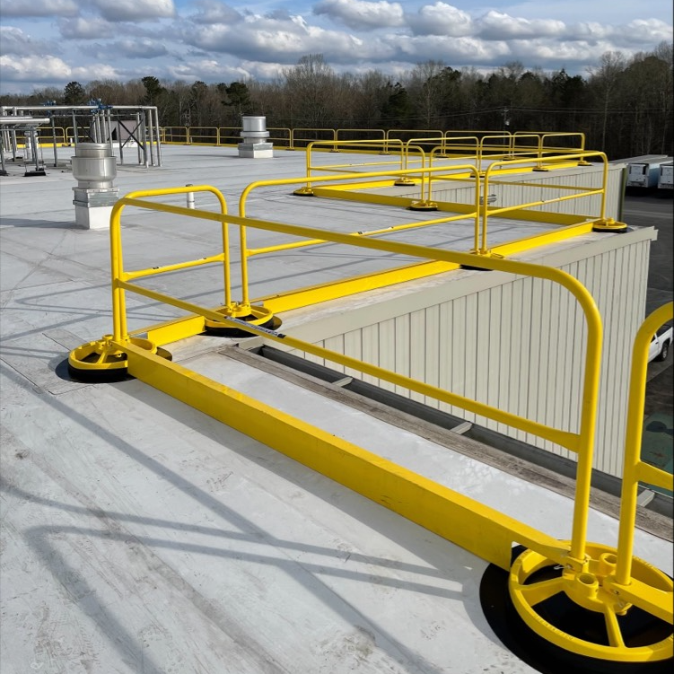
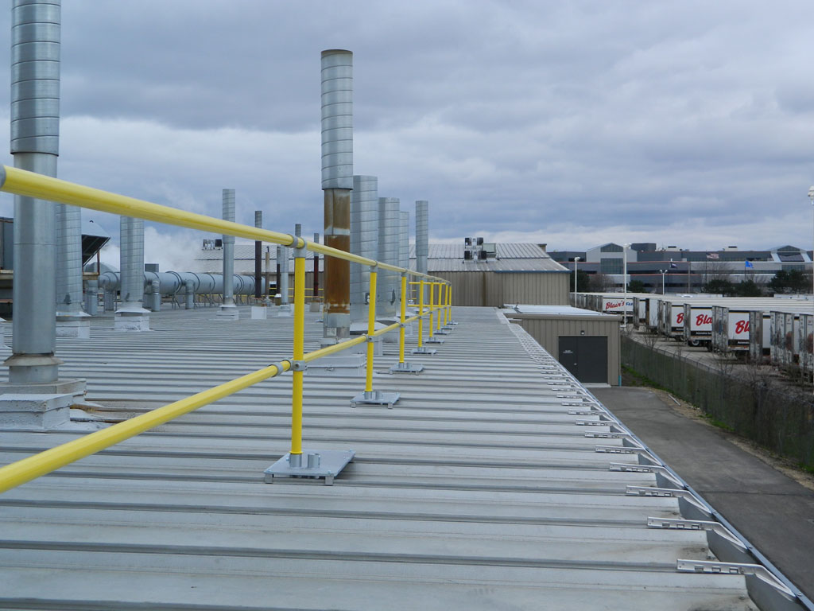
Walking and Working Surfaces
Measures to Ensure Compliance
Guardrail System Examples

Slide 16
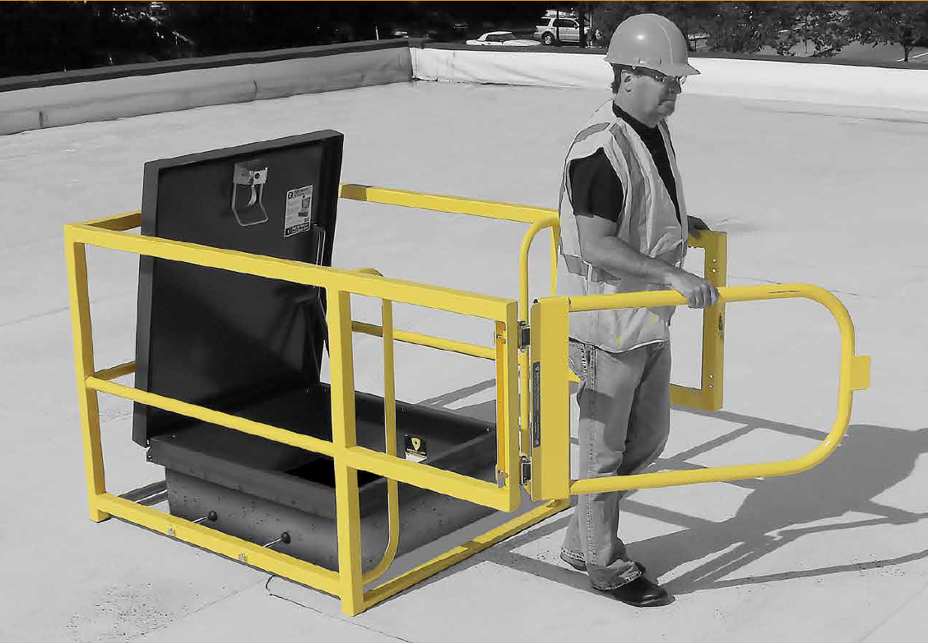
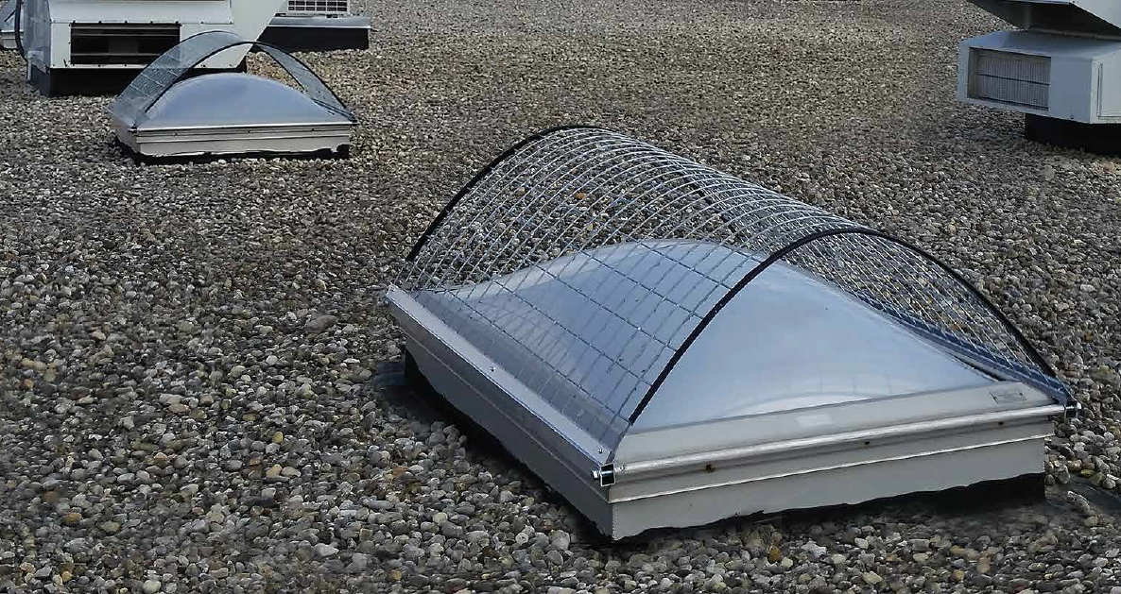
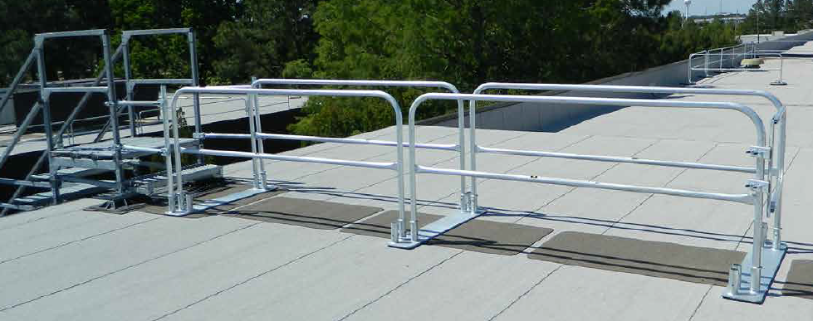
Walking and Working Surfaces
Measures to Ensure Compliance
Roof Hatches Skylights Ladders

Slide 17
Walking and Working Surfaces
Measures to Ensure Compliance
Warning Line System Compliance (1926 Subpart M)
-Flagged at 6-foot (or less) intervals with high-visibility material
-Erected on all sides of work area
-Flag line between 34” and 39” in height
-500-pound tensile strength

Slide 18
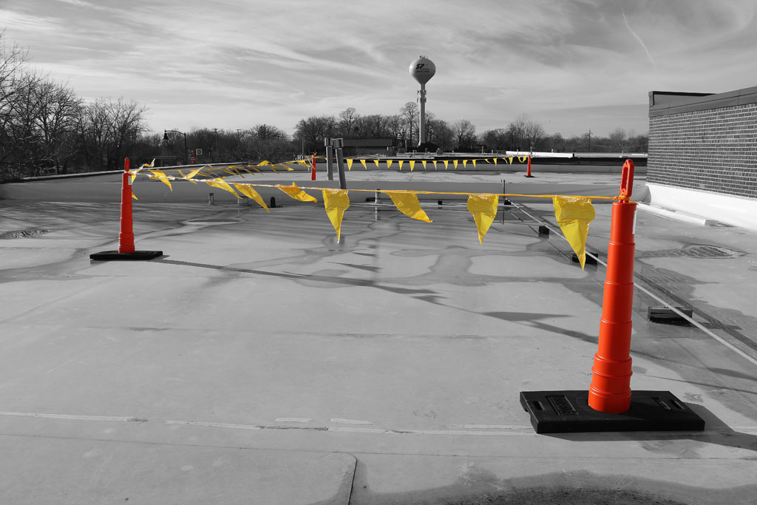
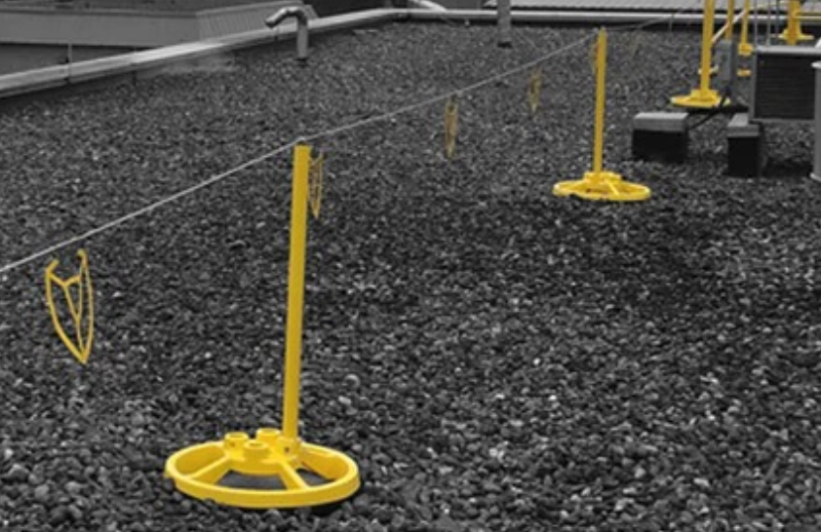
Walking and Working Surfaces
Measures to Ensure Compliance
Warning Line System Examples

Slide 19
Walking and Working Surfaces
Measures to Ensure Compliance
Professional Assistance with Fall-Protection Projects
-Many companies, including Safety Rail Company, specialize in fall- protection compliance and can offer guidance with your project
-Turn-Key service providers can identify your facility’s fall hazards, engineer a site-specific solution, and install your fall-protection system

Slide 20
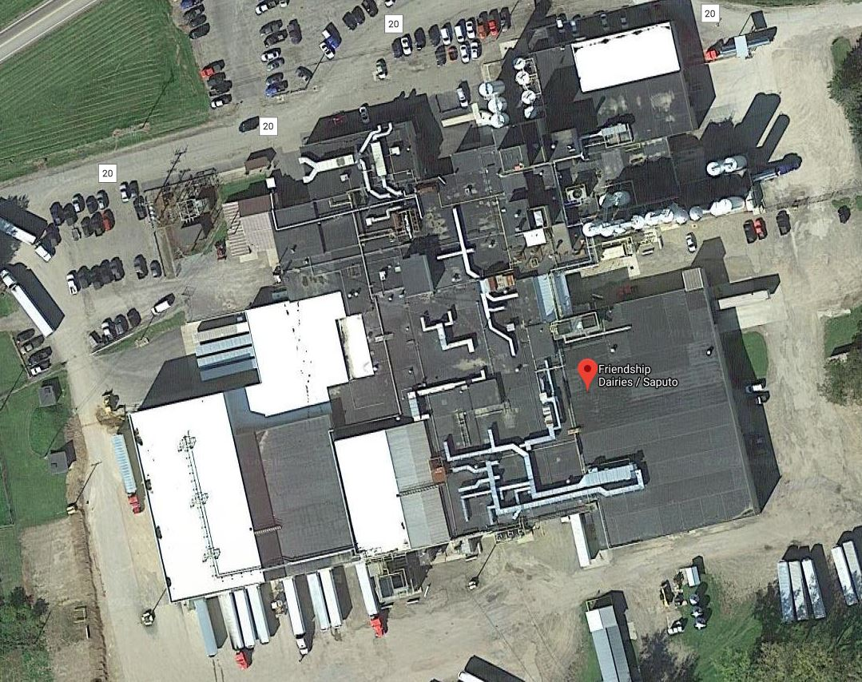
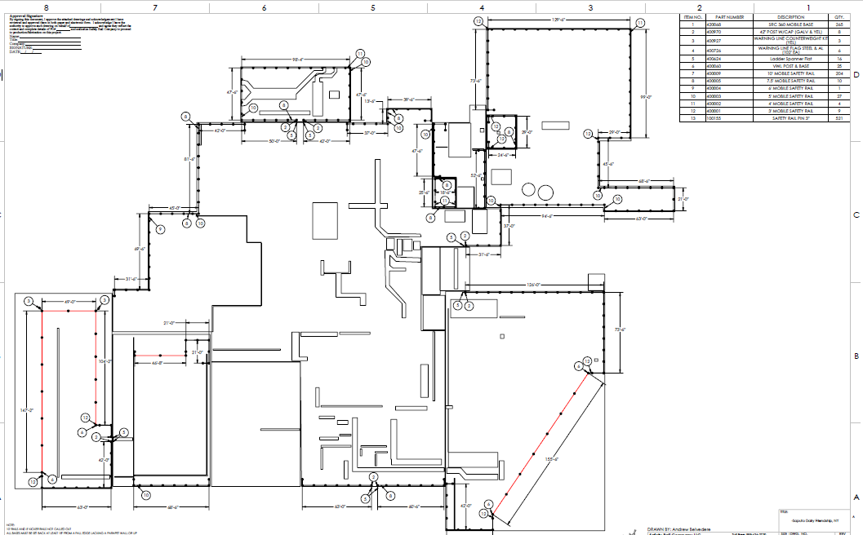
Walking and Working Surfaces
Measures to Ensure Compliance
Things that can be done remotely
-Aerial view CAD Drawing

Slide 21
Walking and Working Surfaces
Measures to Ensure Compliance
“If you fail to plan, you are planning to fail!”
Benjamin Franklin

Slide 22
Walking and Working Surfaces
Measures to Ensure Compliance
Thanks very much for your time!

